Slide 1
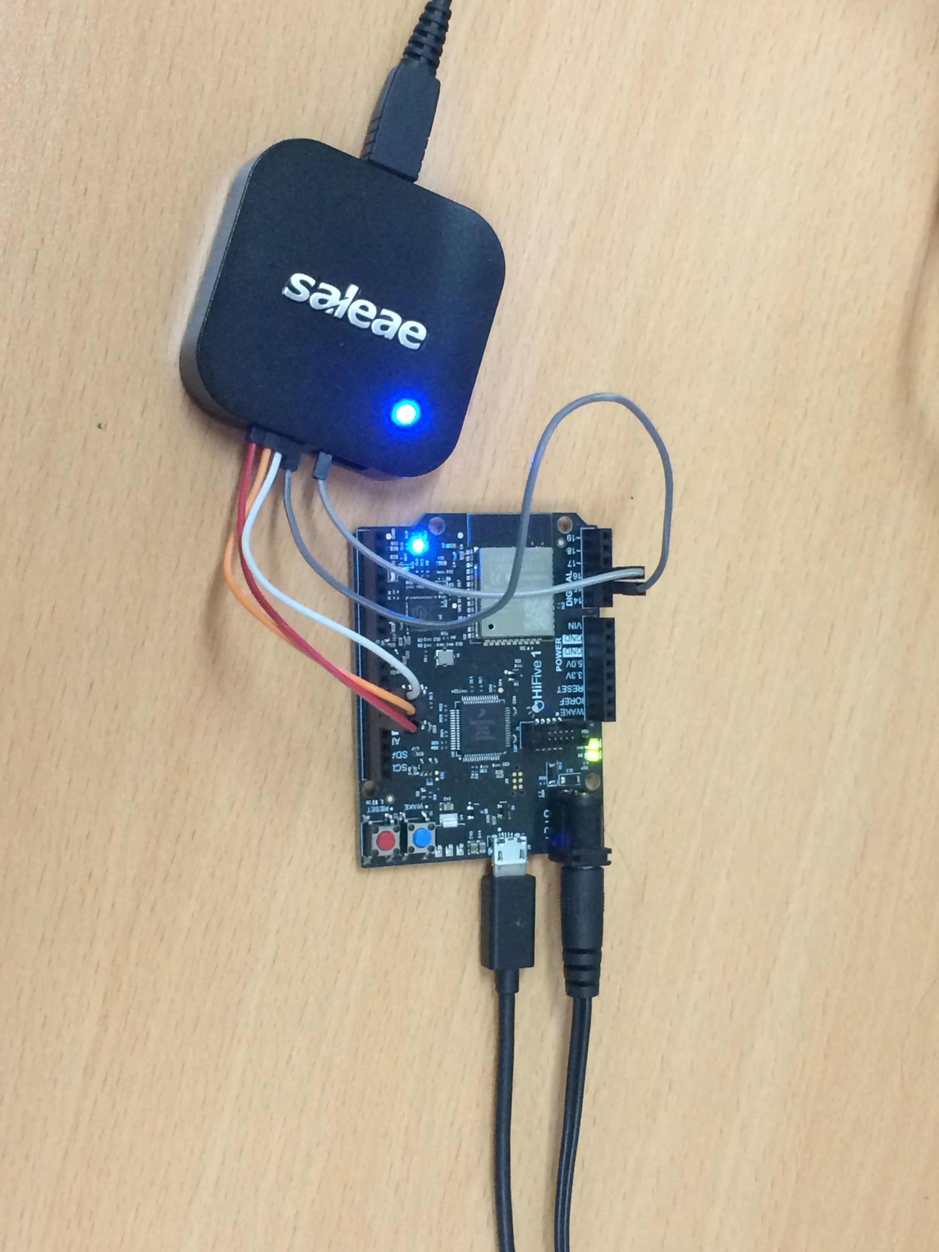
How to build HiFive1 demo using Freefom Studio
Nov-19-2019

Slide 2
Software requirement
Freedom Studio
FreedomStudio-2019-08-1-win64.zip
Demo source code
freertos-code-r2752-trunk_SHC_demo.7z

Slide 3
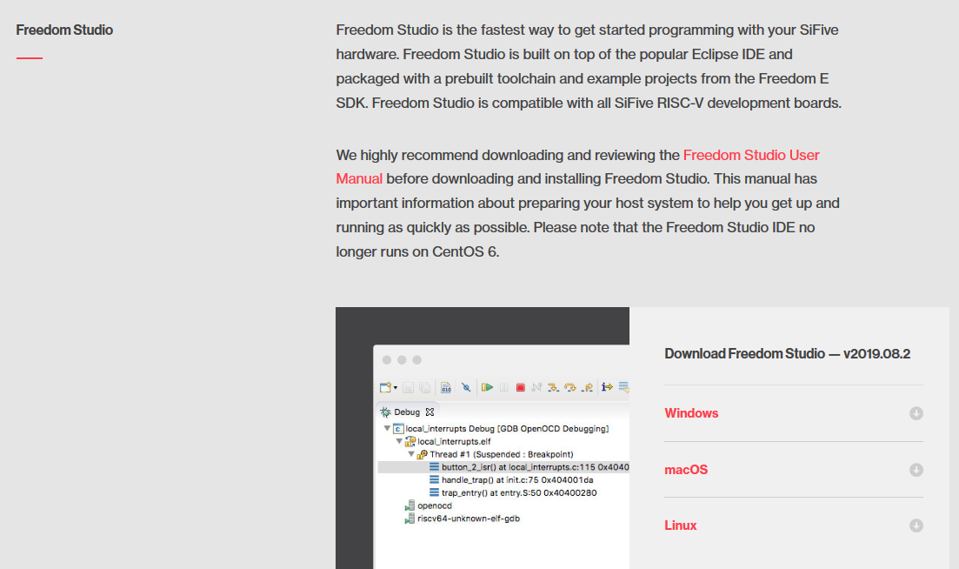
Freedom Studio
Go to https://www.sifive.com/boards
Download Freedom Studio and extract it
(This document use FreedomStudio-2019-08-1-win64.zip)

Slide 4
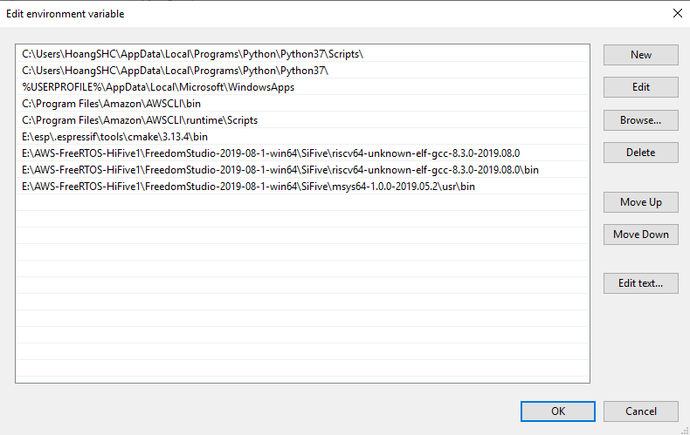
Edit PATH variable for Freedom Studio
Open System Properties
Select Environment Variables... > User variables > Path
Click Edit…
Add new value to PATH
Example in this manual
E:\AWS-FreeRTOS-HiFive1\FreedomStudio-2019-08-1-win64\SiFive\riscv64-unknown-elf-gcc-8.3.0-2019.08.0
E:\AWS-FreeRTOS-HiFive1\FreedomStudio-2019-08-1-win64\SiFive\riscv64-unknown-elf-gcc-8.3.0-2019.08.0\bin
E:\AWS-FreeRTOS-HiFive1\FreedomStudio-2019-08-1-win64\SiFive\msys64-1.0.0-2019.05.2\usr\bin
Click OK

Slide 5
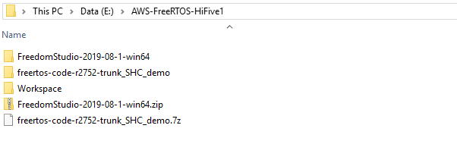
HiFive1 demo
Extract Workspace_FreeRTOS_HiFive1.7z
Create a new folder named Workspace

Slide 6
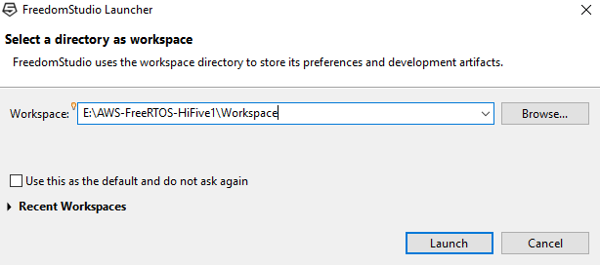
Build HiFive1 demo
Run FreedomStudio and navigate to Workspace

Slide 7
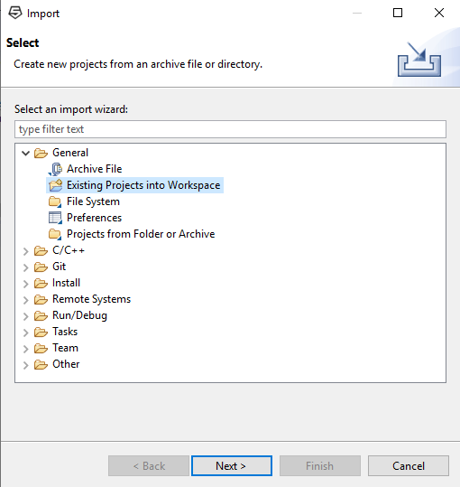
Import Project
In Menu select File > Import
Select General > Existing Projects into Workspace
Click Next

Slide 8
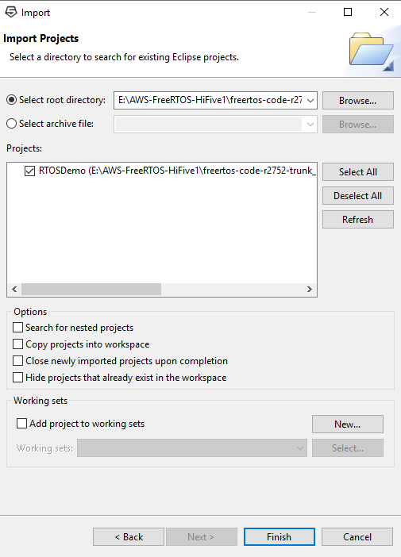
Import Project
Choose Select root directory
Click Browse… and navigate to freertos-code-r2752-trunk_SHC_demo directory
Note: Do not check in Copy projects into workspace
Click Finish

Slide 9
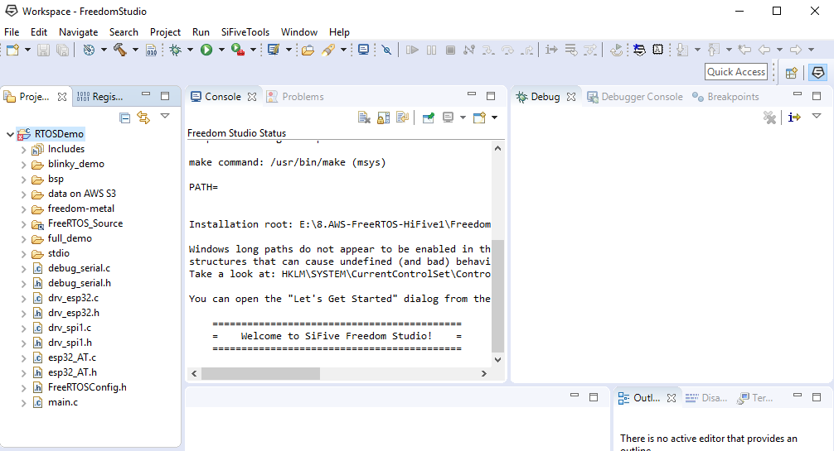
Build HiFive1 demo
Select RTOSDemo and build project

Slide 10
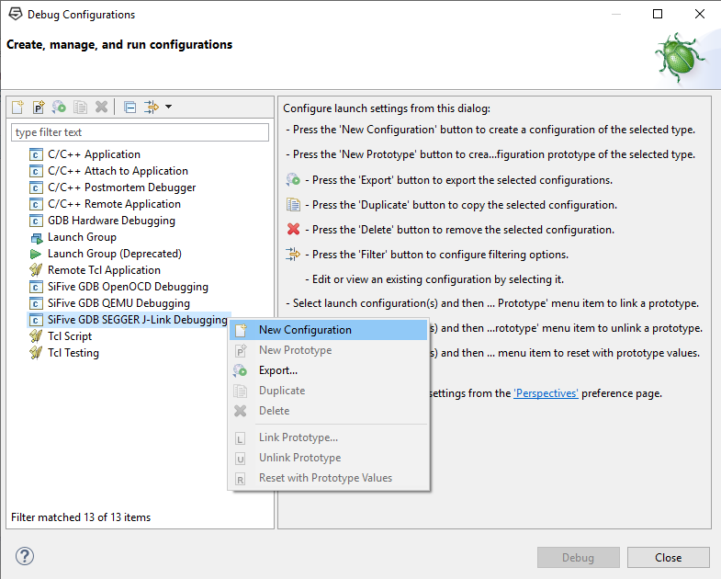
Add new debug configuration
After building finished, connect HiFive1 board to your PC
Right click to project, select Debug As > Debug Configurations …
In Debug Configurations window, select Sifive GDB SEGGER J-Link Debugging
Right click and select New Configuration

Slide 11
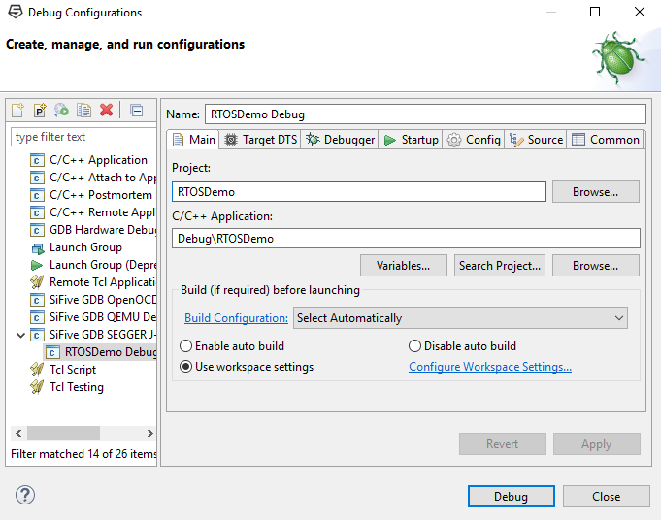
Debug configurations
Project: RTOSDemo
C/C++ Applicaton: Debug\RTOSDemo

Slide 12
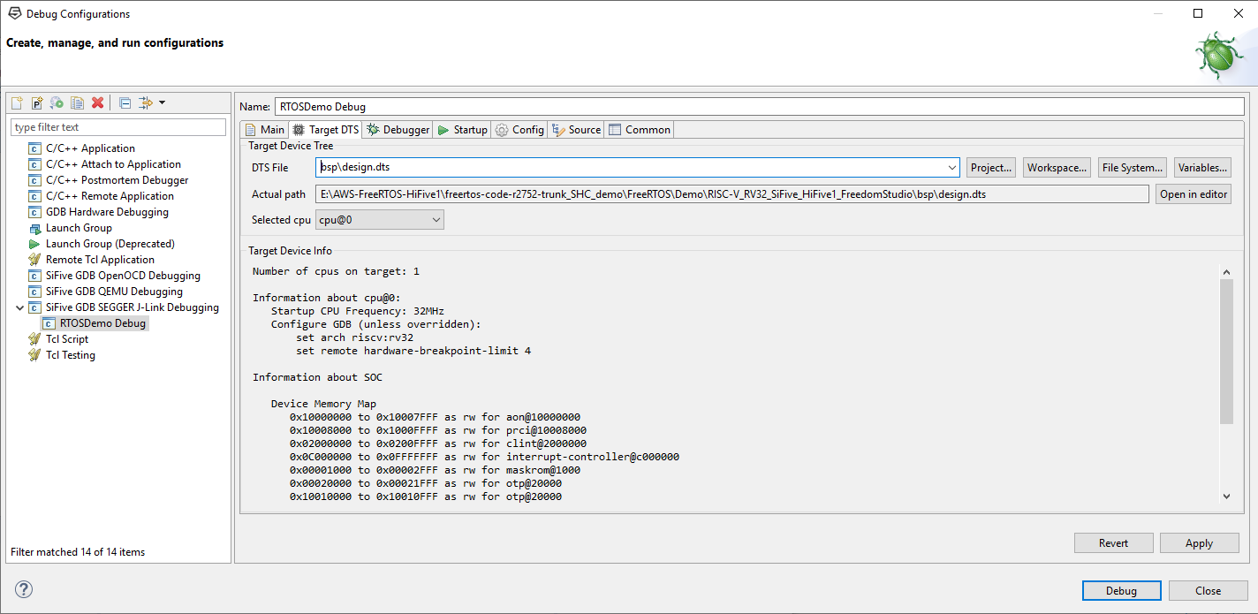
Debug configurations
DTS File: bsp\design.dts
Actual path:
Example:
E:\AWS-FreeRTOS-HiFive1\freertos-code-r2752-trunk_SHC_demo\FreeRTOS\Demo\RISC-V_RV32_SiFive_HiFive1_FreedomStudio\bsp\design.dts
Selected cpu: cpu@0

Slide 13
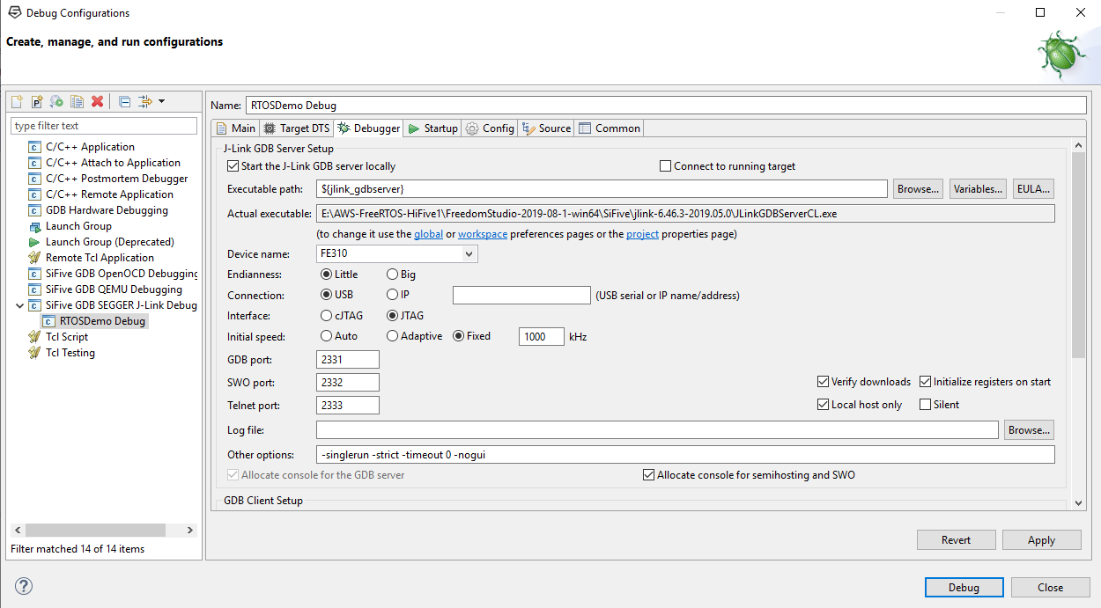
Debug configurations
Device name: FE310
Click Debug and wait to flash binary on board

Slide 14
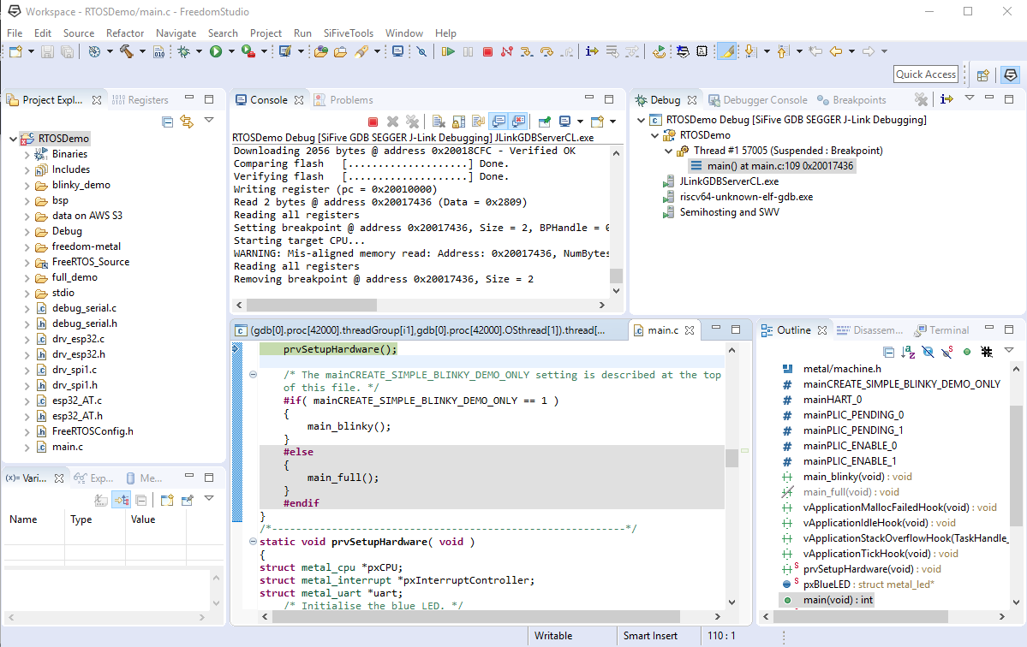
Run HiFive1 demo
Select Terminate to stop Debug
Press RESET button on HiFive1 board to run demo

Slide 15
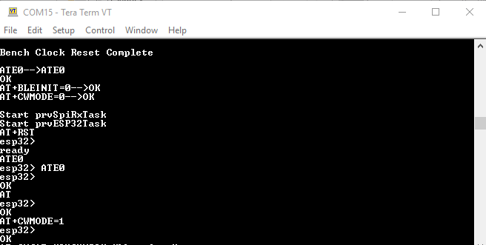
View print log
Use terminal as TeraTerm (baud rate = 115200) to see log

Slide 16
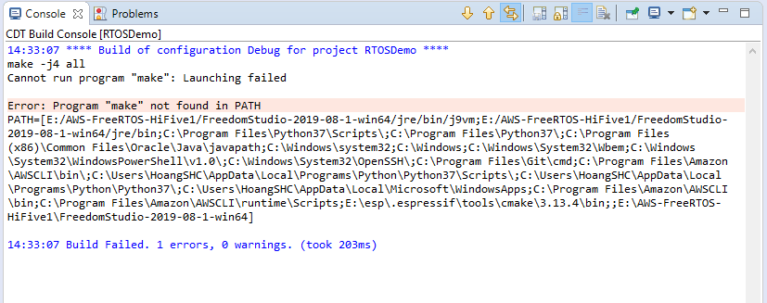
Build error
Refer to slide 4 “Edit PATH variable for Freedom Studio” if see this error

